Slide 1

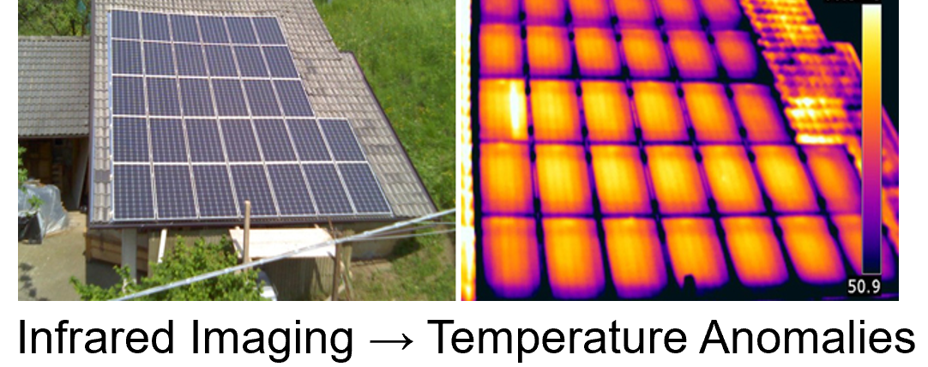
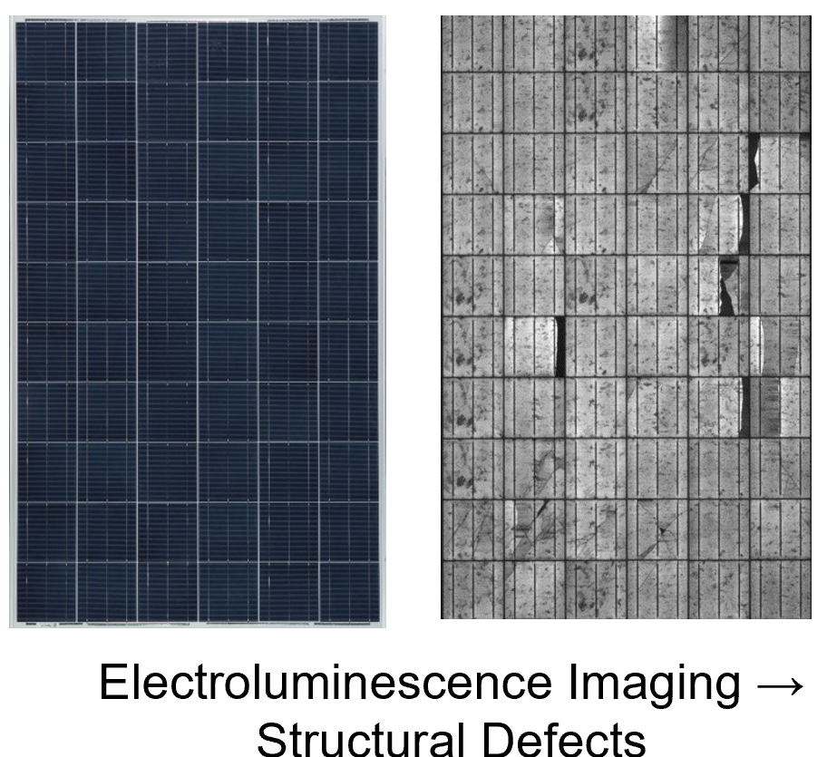
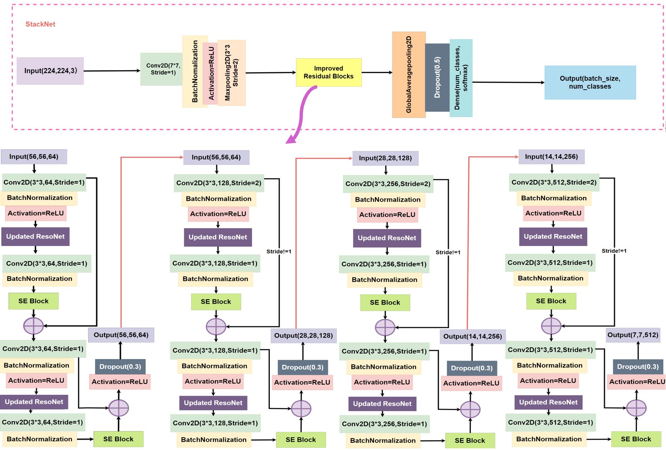
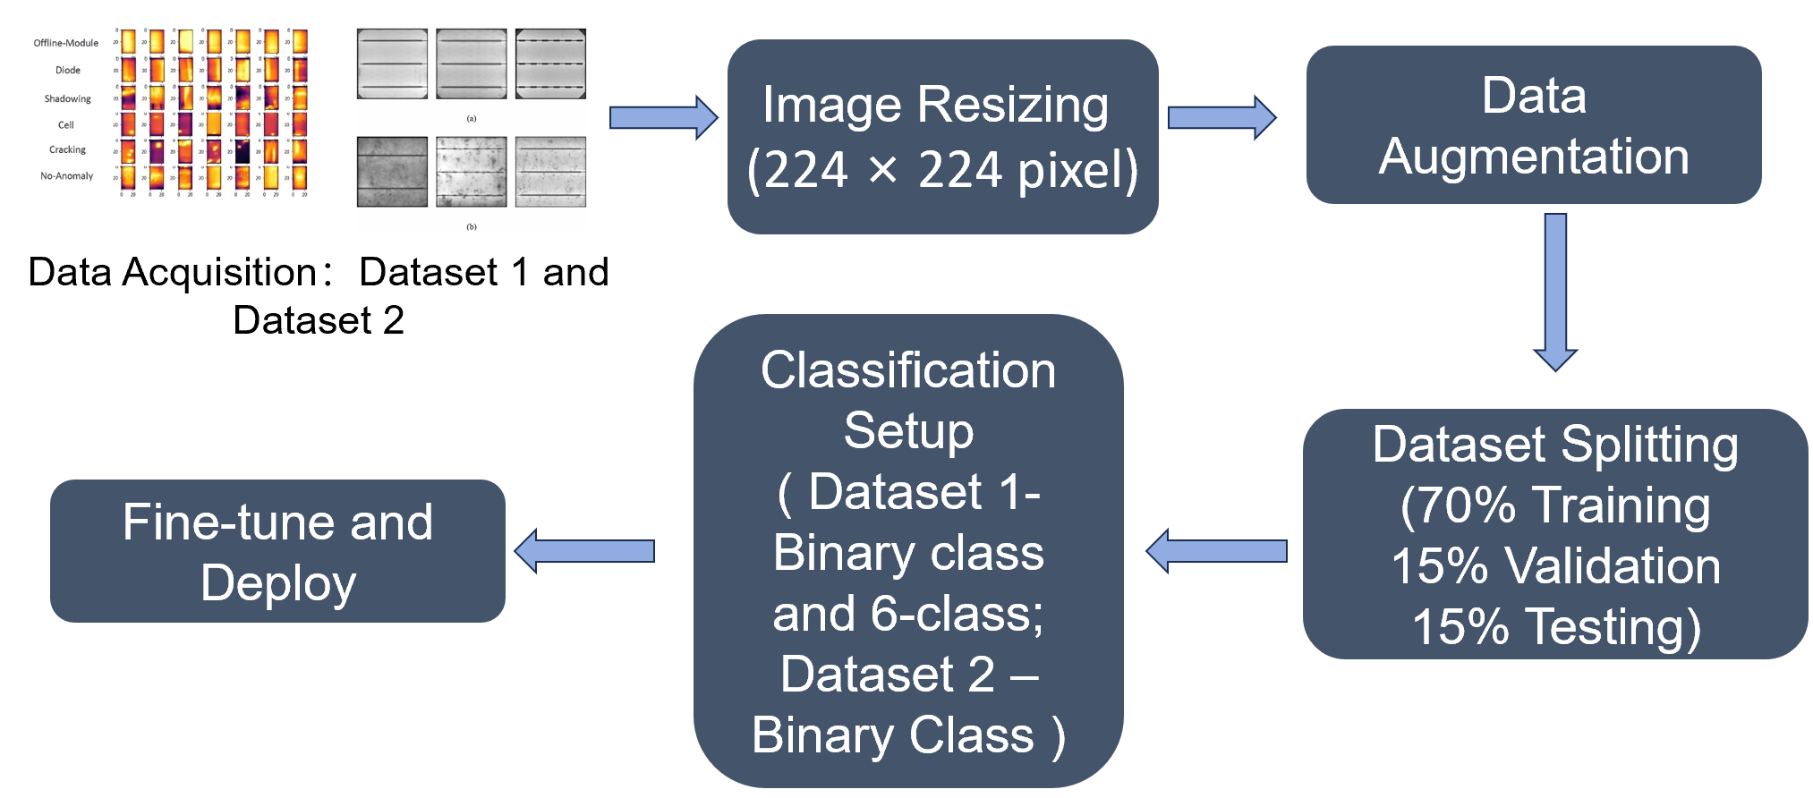
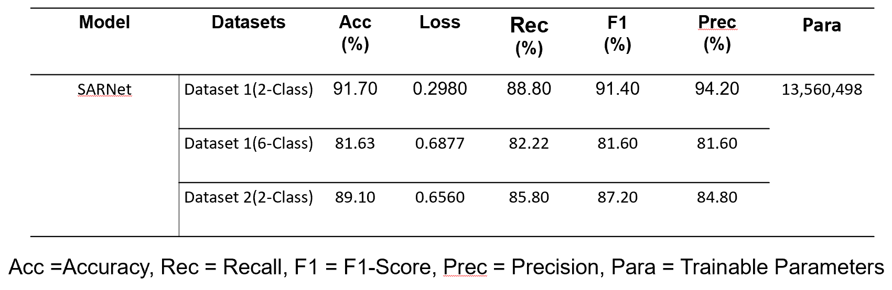
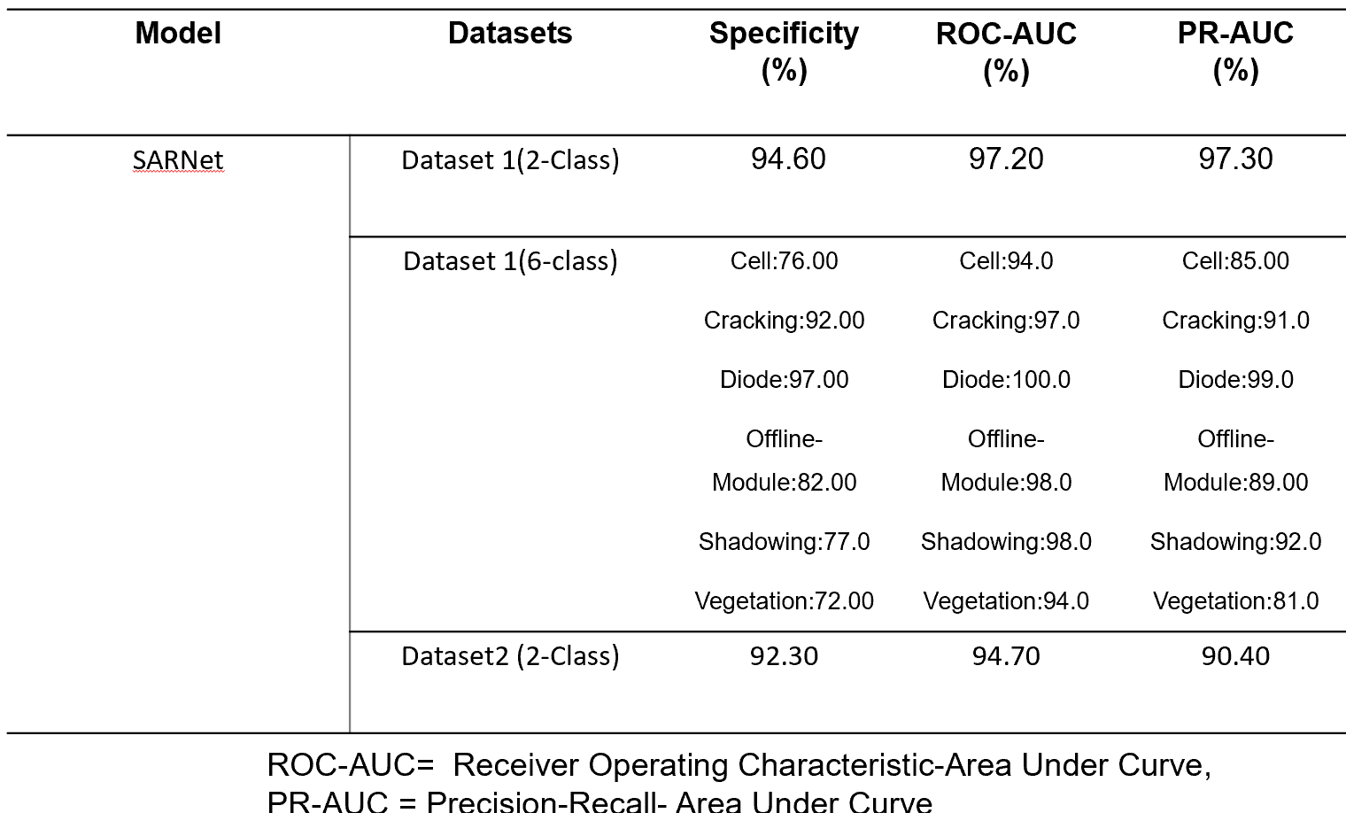
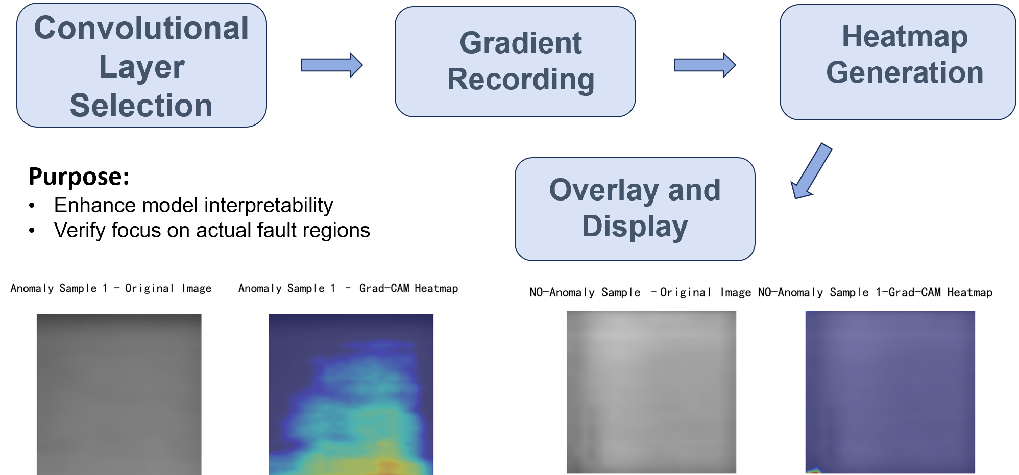
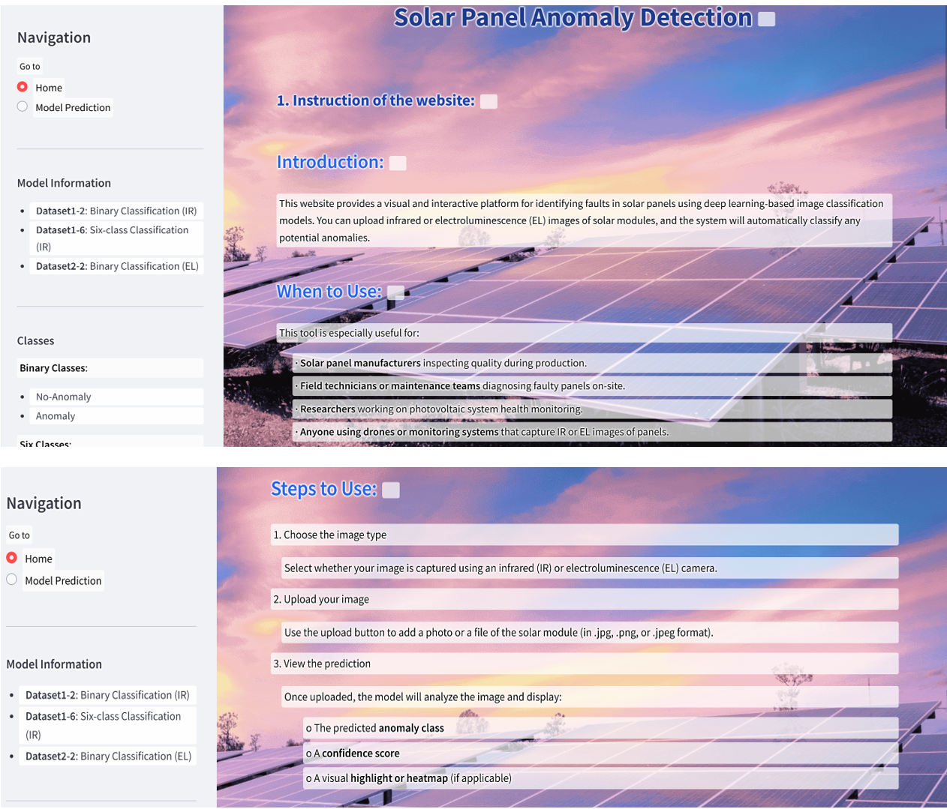
OXFORD
BROOKES
UNIVERSITY
Solar Panel Anomaly Classification using SARNet Model
Supervised By Dr. Grace Ugochi Nneji
LiXiang(Sienna)
Chengdu University of Technology, CDUT Sino-British Collaborative Education
Abstract
This project presents a deep-learning-based system for diagnosing solar panel faults using IR and EL images. The SARNet model, combining StackNet, ResoNet, and attention mechanisms, extracts multi-scale and context-aware features. Trained and tested on IR images for binary and six-class classification, as well as on the ELPV dataset for binary fault detection, it delivered 91.7% and 91.4% in accuracy and F1 - score respectively for IR binary classification, 81.63% accuracy for IR multi - class classification, and 89.1% accuracy for the ELPV binary classification, proving its robustness across diverse fault scenarios.
Figure 1: Infrared Image and EL Image
About dataset 1:
The SARNet model, combining StackNet, ResoNet, and attention mechanisms, extracts multi-scale and context-aware features.
The training is evaluated with Accuracy, Loss, Precision, Recall, Specificity, F1-Score, AUC, ROC, and the total parameters of the network.
Dataset & Data Process
Implementation & Results
Modality: Infrared Imaging
Resolution: 24 x 40 pixels
Classes: 6 ( 5 fault types + 1 No-Anomaly)
Fault Types: Vegetation, Diode, Shadowing, Cell, Cracking, and Offline-Module
Purpose: Main dataset for fault classification
Advantage: Enables multi-class detection of solar panel issues
About dataset 2:
Modality: EL Imaging
Resolution: 300 × 300 pixels
Classes: 2 classes (No Defect, Defected)
Defects: Micro-cracks, soldering faults, disconnected cells
Role: Supplementary dataset for generalization
Advantage: High-resolution data reveals hidden internal defects
Data Processing:
Figure 3: Model Overview
Figure 2:Data Processing Process
Deployment
Model Explainability — Grad-CAM Heatmap :
Figure 4: Training Results Summary
Conclusion
Enabled effective detection of various solar panel faults
Improved accuracy in both binary and multi-class classification through hybrid model design
Enabled real-time fault identification
Deployed the model
Figure 5:Model Explainability Process
GUI: In order to improve the usability and interactivity of deep learning models in actual solar panel fault detection scenarios, this project built a web-based graphical user interface (GUI) to visualize the detection results and support users to upload images for automatic recognition.
Reference
[1] ‘Infrared Solar Modules’. Accessed: Dec. 18, 2024.
[Online]. Available: https://www.kaggle.com/datasets/marcosgabriel/infrared-solar-modules
[2] ‘Papers with Code - ELPV Dataset’. Accessed: Apr. 07, 2025.
[Online]. Available: https://paperswithcode.com/dataset/elpv
Figure 6:Deployment on Web

